Slide 1
Wildfire Data Collection and Analysis
Final Project - DS 5110
Julian Baker + Konstantinos Theodoropoulos
Notes:
Both (JJ Lead)

Slide 2
Introduction
This project analyzes wildfires in the U.S. and Canada by building a full, end-to-end data pipeline. We brought together two large public datasets, cleaned and merged them, and designed an SQL database to store fire events, locations, weather information, and predictions. Furthermore, we developed analytical queries and predictive models to find trends. While this is a proof of concept, the approach shows how integrating international fire data can support efforts in climate resilience, resource planning, and public safety.
Notes:
Konstantinos
Our project involves building an end-to-end pipeline for analyzing wildfire data in the U.S. and Canada. We combined two large public datasets, cleaned them, and designed an SQL database to store fire events, locations, weather information, and predictions. From there, we created queries and built predictive models to uncover trends. Even though this is a proof of concept, it highlights how integrating data across countries can help support climate resilience, planning, and public-safety efforts.

Slide 3
Goals for the Project
Collect and merge wildfire datasets from open, publicly available sources.
Clean and preprocess the data to prepare the dataset for analysis.
Design an SQL database for fire events, locations, weather data, and predictions.
Produce advanced SQL queries and reports.
Build and evaluate predictive models.
Notes:
Konstantinos
For this project, our main goals were to build the full pipeline we would need to analyze wildfire behavior. We started by collecting and merging publicly available datasets from the U.S. and Canada. A big part of the work involved cleaning and preprocessing the data so it was consistent and ready for analysis. After that, we designed an SQL database to organize fire events, locations, weather information, and, later on, our model predictions. With that structure in place, we created more advanced SQL queries and reports to explore patterns in the data. Finally, we used this cleaned and structured dataset to build and evaluate predictive models that could help us understand wildfire risk and identify the factors that influence it.

Slide 4
Datasets we used
We used these two datasets for our project, one from the U.S., and the other from Canada:
U.S.: Covering 2.1 million U.S. wildfire records from 1992-2018, this well-maintained dataset includes essential cleaning and necessary fields such as location, fire start and suppression dates, size, etc. It provides a baseline for analyzing where a fire occurred, how long it lasted, and their overall impact.
Canada: The Canadian National Fire Database (NFDB) compiles wildfire locations from several agencies, and provides data such as latitude/longitude, fire start and end dates, fire size, cause, and type.
Notes:
Konstantinos
For our analysis, we used two major public wildfire datasets, one from the U.S. and one from Canada. The U.S. dataset covers about 2.1 million wildfire records from 1992 to 2018. It’s very well-maintained and already cleaned, and it includes the key fields we need, like location, fire start and containment dates, and fire size. For Canada, we used the National Fire Database. It collects wildfire reports from different federal and provincial agencies and includes similar attributes, like latitude and longitude, start and end dates, fire size, cause, and fire type. The structure is very similar to the U.S. data, which made it easier to combine and analyze them together.

Slide 5
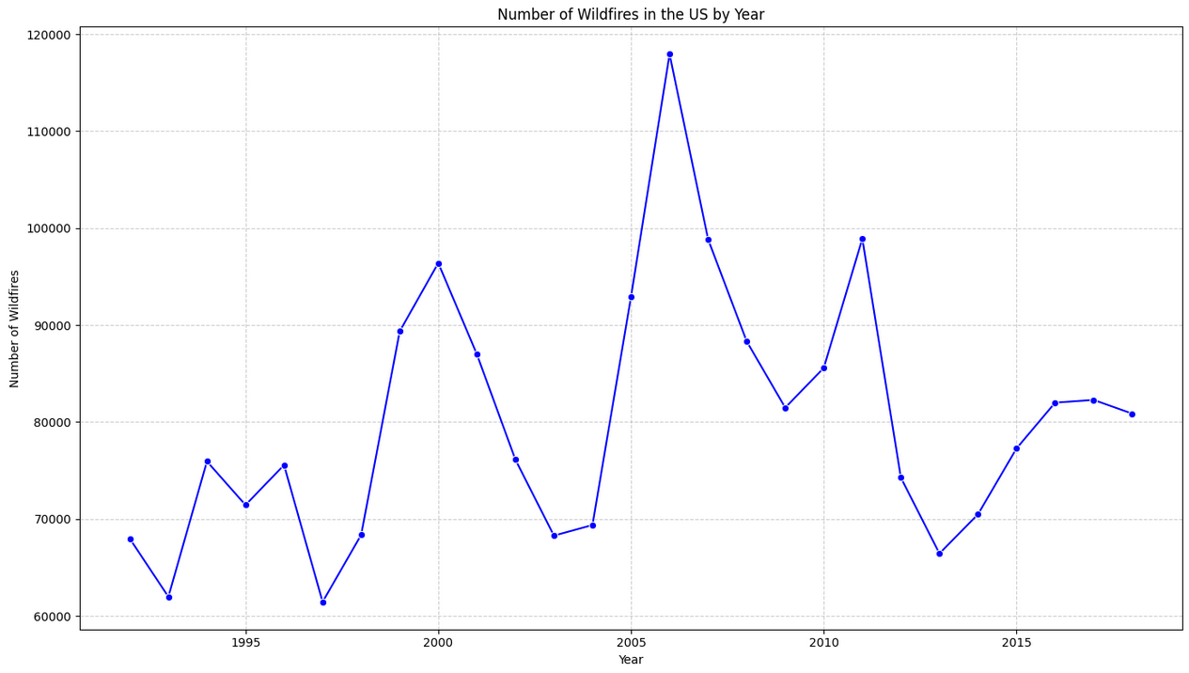
Brief Overview of US Data
From National Fire Program Analysis (FPA) system
5th edition of data (6th exists, goes to 2020)
1992-2018
2166753 entries
Merge of Federal, state, and local fire organizations’ records
Redundant records removed (to the extent possible)
Columns of note: Discovery date, Contain date, Fire Size, Fire Size Class, Latitude, Longitude, County.
CSV file explaining each column
Notes:
JJ

Slide 6
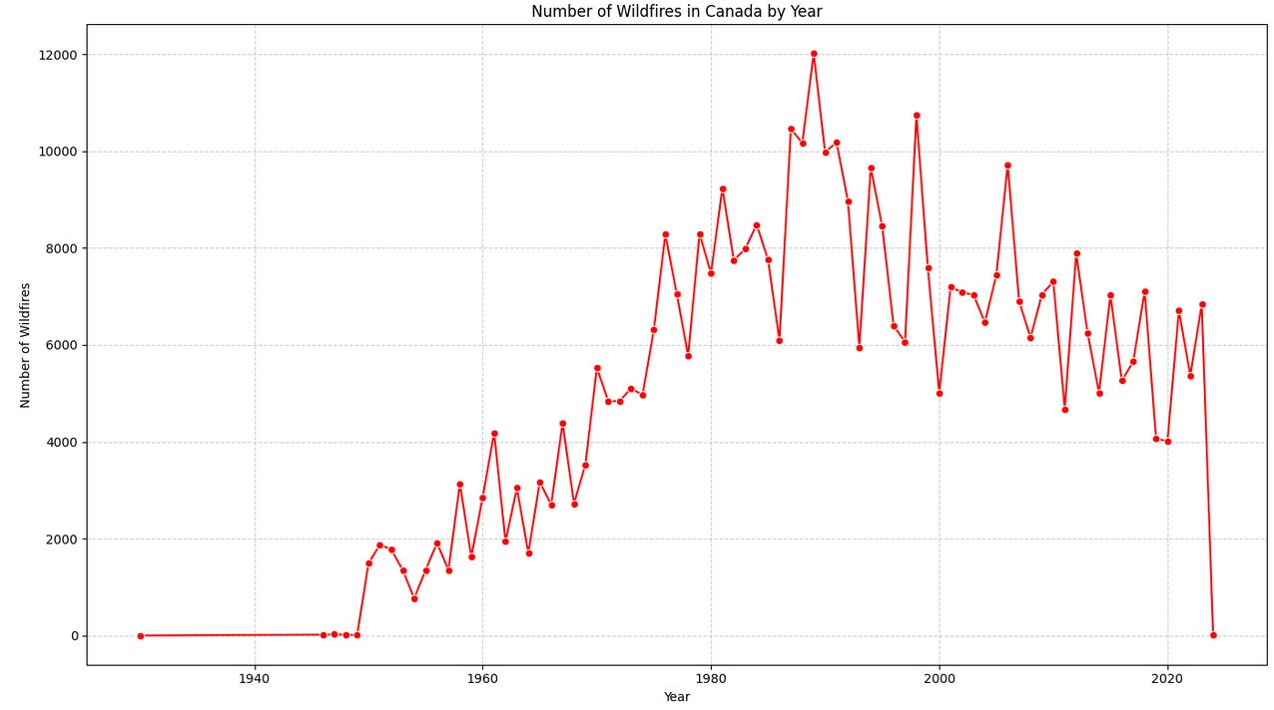
Brief Overview of Canada Dataset
From 1930 to 2024
Similar merge of data to US
436564 Entries
No subregion equivalent column to counties (territories, provinces, or districts)
Lacks wildfire size class
Not entirely consistent in record keeping over time
Notes:
JJ

Slide 7
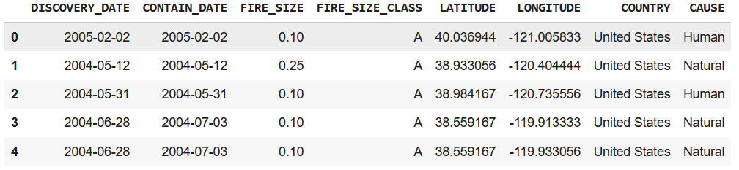
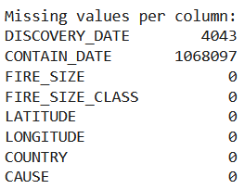
Combined Dataset Overview
2603317 Entries
Combination 7 common columns
Formatting merge on date
Created Fire Size Class for Canadian Wildfires
Cause has its own version of missing values
Notes:
Konstantinos
After merging the U.S. and Canadian data, we ended up with about 2.6 million records. We focused on seven columns that both datasets had in common and had to clean things like date formatting so they matched. We also added a fire-size class to the Canadian data to keep it consistent with the U.S. system. One thing we ran into was that each dataset handled missing ‘cause’ values differently, so we had to standardize those before moving on.

Slide 8
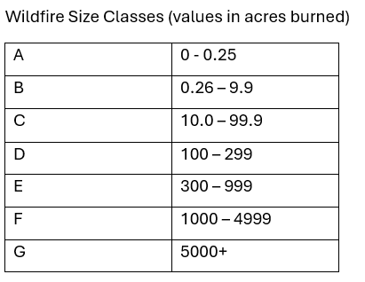
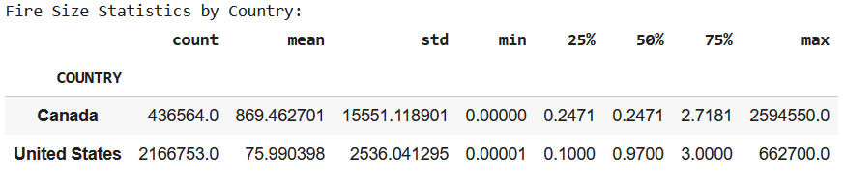
Issues with Measurement
How do we handle different groups using different measurements?
Hectares to Acres (x2.471)
Which system to use
Effect of conversion
0.2471 wildfire size from Canada
Wildfire size classes
Notes:
JJ

Slide 9
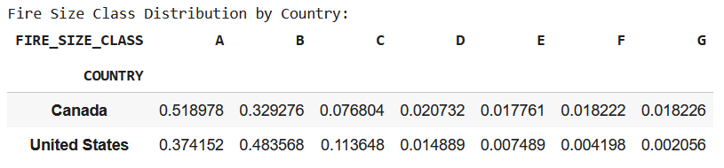
Wildfire Size Class Distribution
Still 12412 entries of wildfires that burned 5000+ acres
Notes:
JJ

Slide 10
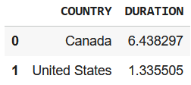
Duration
Calculated by taking the number of days between when a wildfire was first reported and when wildfire was extinguished
Missing values removed
Average Duration by Country:
Notes:
JJ

Slide 11
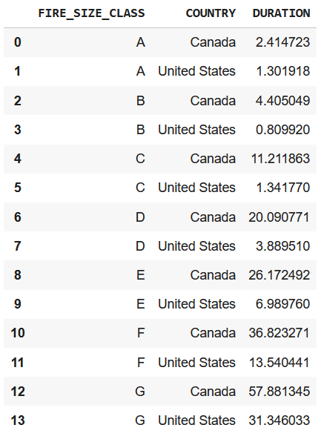
Duration and Wildfire Size Class
Canadian wildfires lasted longer on average across the board
Nearly 2x as long
Suspect population to be a factor there
The larger the wildfire, the longer it lasted in days for both countries
One exception: Class B wildfires in US
Case of “first reported” ≠ “first day of fire”
Notes:
JJ

Slide 12
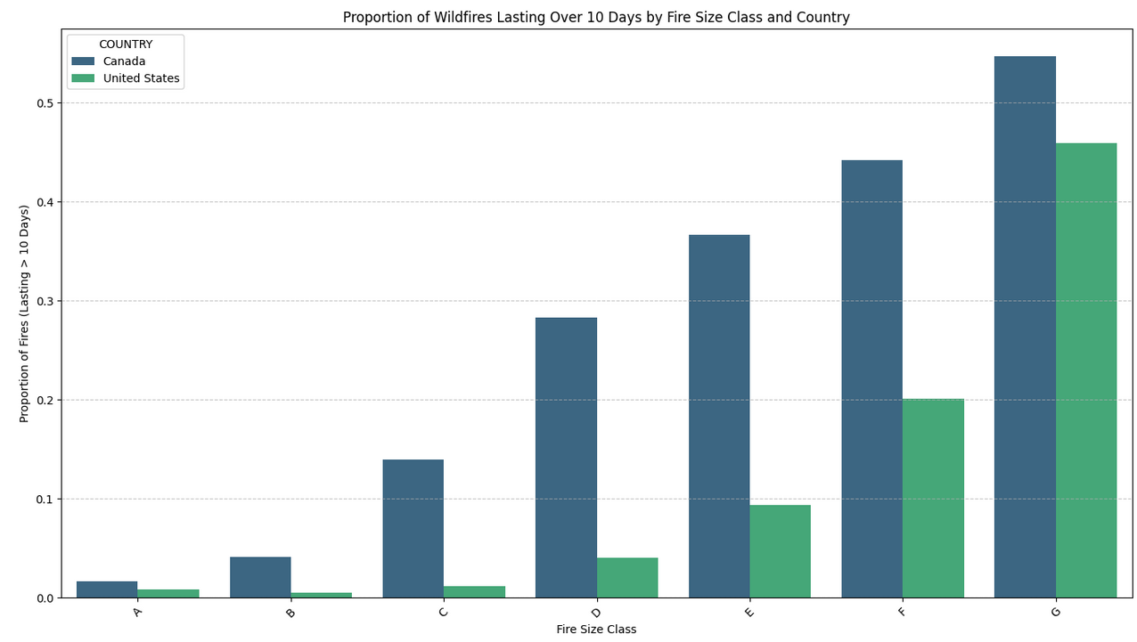
Graphs of Duration
Proportion refers to # of wildfires in class that lasted over 10 days / # of wildfires in class
Lines up much more clearly with expectations than count
Canada continues to have longer lasting fires
50% of class G wildfires in Canada lasted over 10 days
Notes:
JJ

Slide 13
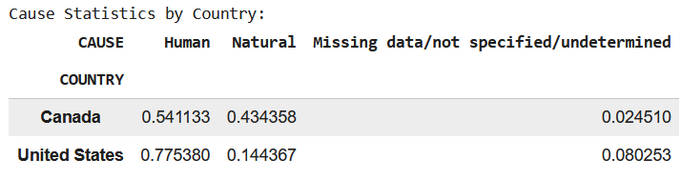
Analysis of Cause
US dataset had a more detailed cause column, but Canada dataset did not
Human, Natural, and Missing data
About 8% missing across the board (by fire size class)
Far more likely to be caused by a human than naturally in US
May be a case of small wildfires being mainly caused by humans, which make up the majority of the data
Notes:
JJ

Slide 14
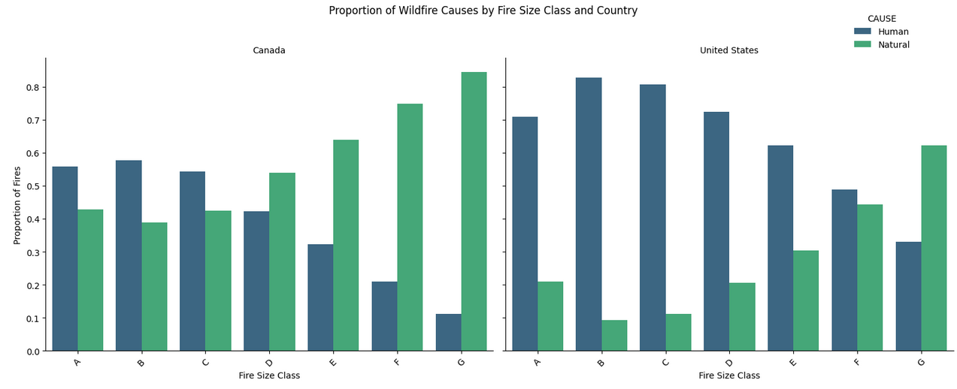
Graph of Cause
Notes:
JJ

Slide 15
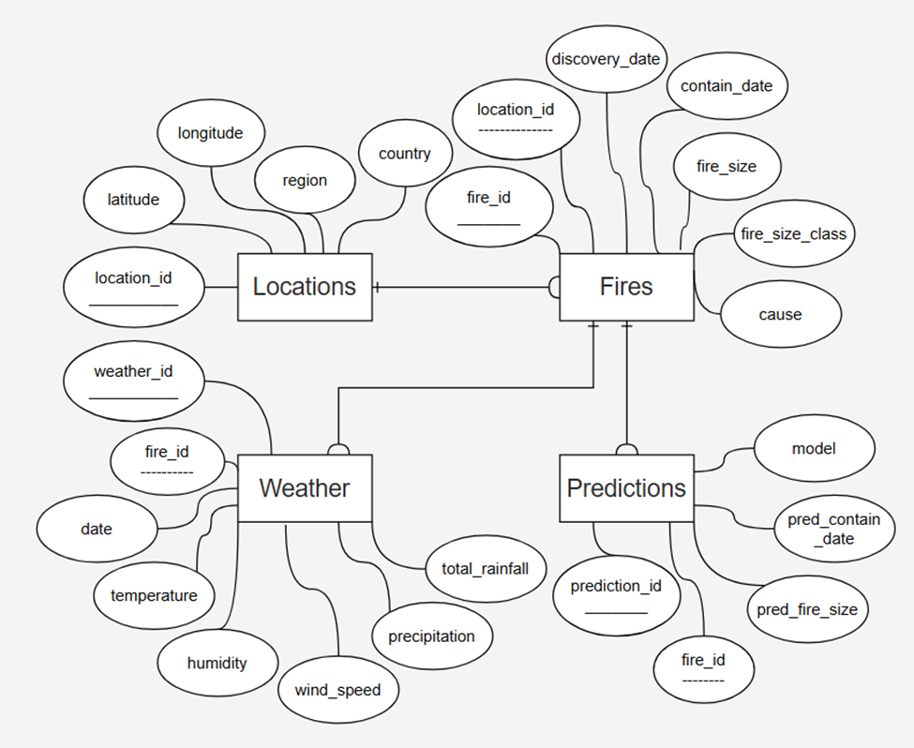
SQL Database Design
Notes:
Konstantinos
Entities & attributes
Our ERD shows the four main tables we used to organize the data. We separated locations into their own table because many fires can happen in the same place, so Locations just stores the latitude, longitude, region, and country with a unique ID. The Fires table holds the core fire information; things like discovery date, containment date, size, and cause, and each fire links back to a location through a foreign key. We also added a Weather table. Since weather can change throughout the duration of a fire, one fire can have multiple weather records, each with temperature, humidity, wind, and precipitation values for specific dates. Finally, we included a Predictions table so we could store the results from different models. A single fire can have multiple predictions if it’s evaluated by more than one model. Overall, this structure keeps the data clean, avoids repetition, and makes it easy to scale or run more complex analyses.

Slide 16
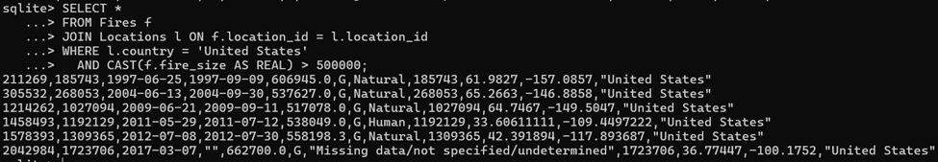
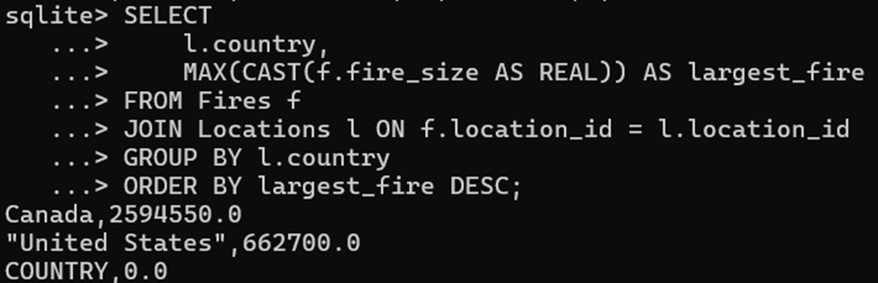
SQL Query Samples
Notes:
Konstantinos
Now that we’ve seen how the database is designed, here are some SQL queries that show what it lets us analyze.
US, >500,000 acres
Largest fires by nation

Slide 17
Modeling
Goal: apply predictive modeling for fire occurrence or intensity prediction
Tools of measurement: accuracy, recall, and ROC-AUC
Predictor columns used: Duration, Start_Month, Start_Year, Country, Cause
Last two columns used one-hot encoding - presents challenge if expanded
Potentially useful columns not present
Need to limit the range of values (1992-2017)
2018 could be used as testing data set
Issues with modeling fire occurrence
Had to measure intensity via wildfire size
Models selected: linear regression and random forest
Notes:
JJ

Slide 18

Model Cont.
Both models did poorly in predicting wildfire size
Suggests that the variables are not fit to make such models
Random Forest did get 56% accuracy….
But recall the distribution of the data
Random forest would simply never predict classes D-G to get good accuracy
Issue of a skewed dataset
Notes:
JJ

Slide 19
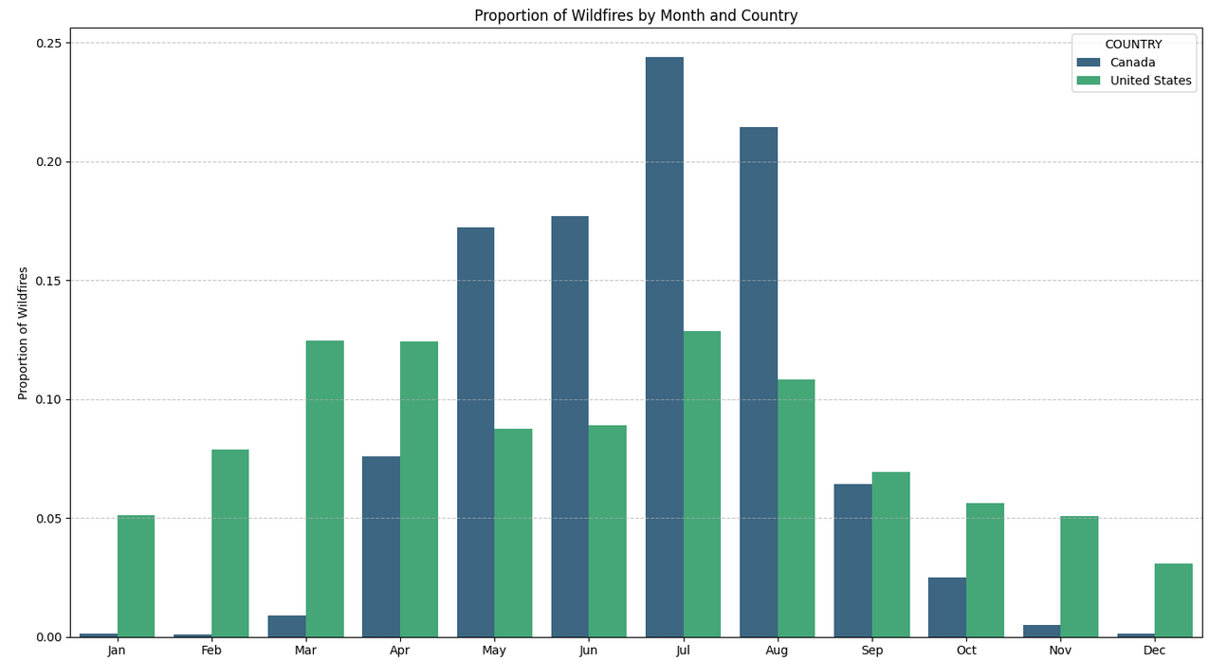
A look at the Month and Wildfires
US is more consistent year around, Canada spikes in the spring/summer.
May and June in the US is surprisingly low.
Shows a trend the model could not handle, lack of weather data
Notes:
JJ

Slide 20
Challenges / Ideas for Further Improvement
Missing values
Spatial graphing/heatmap
Building the schema
More datasets to add for specific columns:
Location data - namely subregions in Canada
Weather data (wind, precipitation, soil, etc.)
Population data
Notes:
JJ

Slide 21
Conclusions
Demonstrated a need for a unified, clearly structured database.
Designed an SQL database, showing how it could be scaled with additional data types and sources.
Identified what variables are needed for stronger predictive modeling.
Identified a seasonal pattern; a relationship between number of wildfires and month.
Notes:
Konstantinos
In the end, we showed that having a unified, well-structured wildfire database really does make a difference, especially when combining data from the U.S. and Canada. We built a schema that can easily scale with more data, figured out which variables are most important for better predictive models, and found clear seasonal patterns, including how wildfire counts change month to month. Overall, this gives us a solid starting point for expanding the analysis or improving the modeling.

Slide 22
Sources
Short, Karen C. 2021. Spatial wildfire occurrence data for the United States, 1992-2018 [FPA_FOD_20210617]. 5th Edition. Fort Collins, CO: Forest Service Research Data Archive. https://doi.org/10.2737/RDS-2013-0009.5
Natural Resources Canada. 2024. National Fire Database: Fire Point Data (NFDBPNT). Canadian Wildland Fire Information System. https://cwfis.cfs.nrcan.gc.ca/datamart/download/nfdbpnt
Notes:
Konstantinos

